Slide 1

REDOX Practice
Get out 3 sheets of paper.
You need your reference table too.

Slide 2
Copy
Aluminum and chlorine form aluminum chloride (synthesis reaction, also redox)

Slide 3
Aluminum and chlorine form aluminum chloride (synthesis reaction, also redox)
Al_{(S)} + Cl_{2(G)} → AlCl_{3(S)} balance this now

Slide 4
Aluminum and chlorine form aluminum chloride (synthesis reaction, also redox)
2Al_{(S)} + 3Cl_{2(G)} → 2AlCl_{3(S)} add oxidation numbers

Slide 5
Aluminum and chlorine form aluminum chloride (synthesis reaction, also redox)
2Al°_{(S)} + 3Cl₂°_{(G)} → 2Al⁺³Cl₃^{–1}_{(S)}
All atoms have a zero-oxidation number, their protons = electrons, no charge
Ionic compounds have ionic charges. Each Al is +3, so you NEED 3 Cl which are –1.
The whole ionic compound is neutral, but its parts are charged.

Slide 6
Aluminum and chlorine form aluminum chloride (synthesis reaction, also redox)
2Al°_{(S)} + 3Cl₂°_{(G)} → 2Al⁺³Cl₃^{–1}_{(S)}
Decide what changes, what becomes MORE positive (loses electrons) – oxidizes?
What becomes more negative (gains electrons) – reduces?

Slide 7
Aluminum and chlorine form aluminum chloride (synthesis reaction, also redox)
2Al°_{(S)} + 3Cl₂°_{(G)} → 2Al⁺³Cl₃^{–1}_{(S)}
The aluminum atoms become more positive; they are oxidized into Al⁺³ cations.
The chlorine atoms become more negative; they are reduced into Cl^{–1} anions.

Slide 8
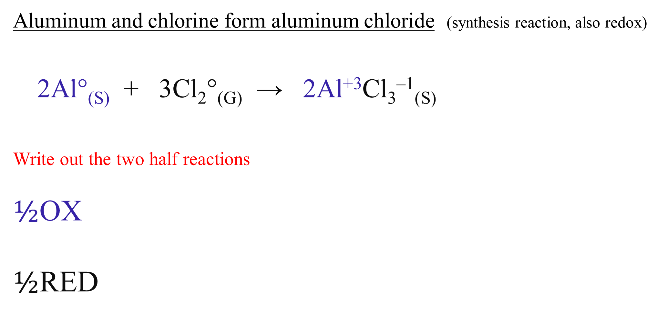
Aluminum and chlorine form aluminum chloride (synthesis reaction, also redox)
2Al°_{(S)} + 3Cl₂°_{(G)} → 2Al⁺³Cl₃^{–1}_{(S)}
Write out the two half reactions
$½$OX
$½$RED

Slide 9
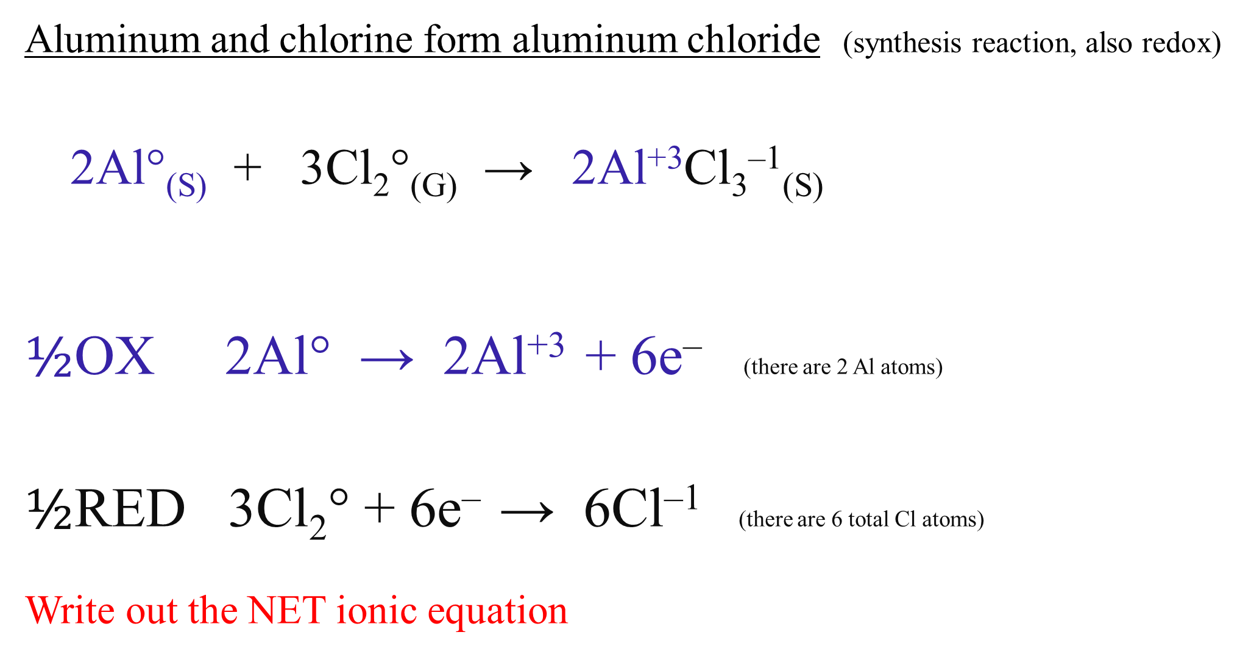
Aluminum and chlorine form aluminum chloride (synthesis reaction, also redox)
2Al°_{(S)} + 3Cl₂°_{(G)} → 2Al⁺³Cl₃^{–1}_{(S)}
$½$OX 2Al° → 2Al⁺³ + 6e– (there are 2 Al atoms)
$½$RED 3Cl₂° + 6e– → 6Cl^{–1} (there are 6 total Cl atoms)
Write out the NET ionic equation

Slide 10
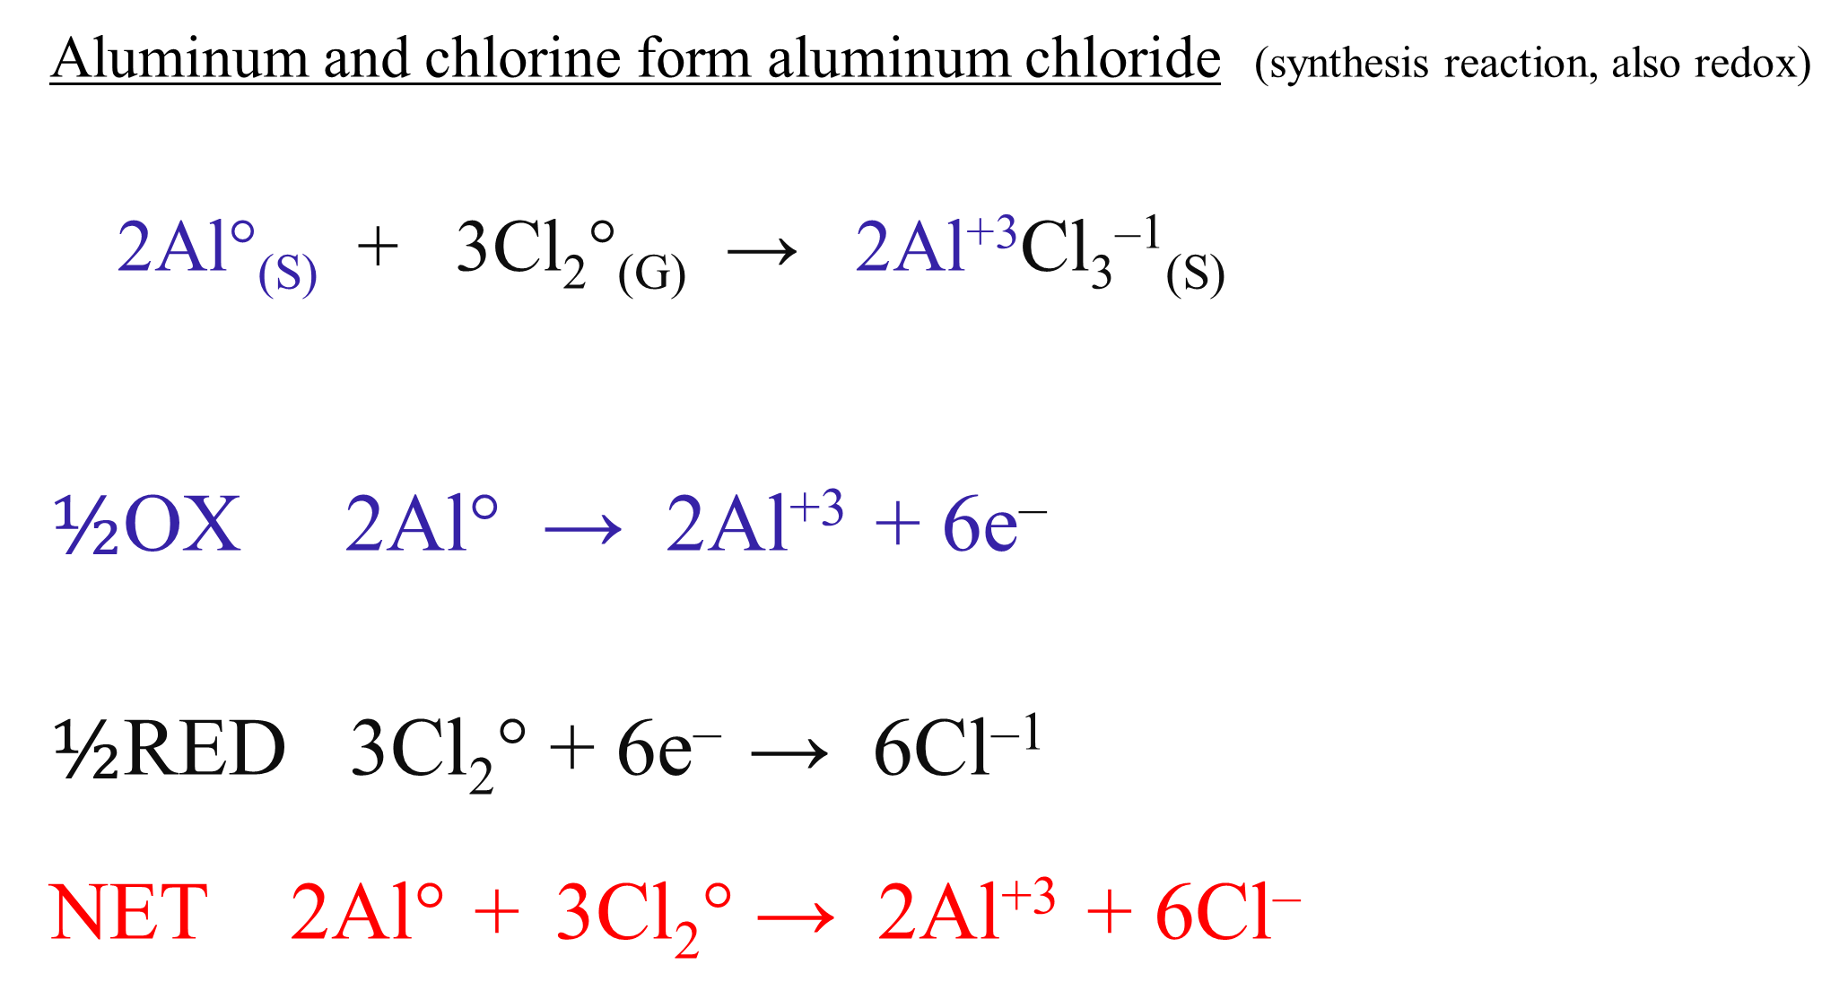
Aluminum and chlorine form aluminum chloride (synthesis reaction, also redox)
2Al°_{(S)} + 3Cl₂°_{(G)} → 2Al⁺³Cl₃^{–1}_{(S)}
$½$OX 2Al° → 2Al⁺³ + 6e–
$½$RED 3Cl₂° + 6e– → 6Cl^{–1}
NET 2Al° + 3Cl₂° → 2Al⁺³ + 6Cl–

Slide 11
Again.
Put zinc metal into a copper I chloride solution.

Slide 12
zinc metal into a copper I chloride solution.
Zn_{(S)} + CuCl_{(AQ)} → ZnCl_{2(AQ)} + Cu_{(S)}
Now balance this

Slide 13
zinc metal into a copper I chloride solution.
Zn_{(S)} + 2CuCl_{(AQ)} → ZnCl_{2(AQ)} + 2Cu_{(S)}
Now put in the oxidation numbers.

Slide 14
zinc metal into a copper I chloride solution.
Zn°_{(S)} + 2Cu⁺¹Cl^{–1}_{(AQ)} → Zn⁺²Cl₂^{–1}_{(AQ)} + 2Cu°_{(S)}
Now determine, which is getting more positive,
which is getting more negative?

Slide 15
zinc metal into a copper I chloride solution.
Zn°_{(S)} + 2Cu⁺¹Cl^{–1}_{(AQ)} → Zn⁺²Cl₂^{–1}_{(AQ)} + 2Cu°_{(S)}
The zinc goes from a 0 → +2 oxidation number, Zn is oxidized.
The 2Cu⁺¹ goes from +1 → 0, it gets less positive, 2Cu⁺¹ is reduced.
The chloride Cl^{–1} anions are the spectator ions.

Slide 16
zinc metal into a copper I chloride solution.
Zn°_{(S)} + 2Cu⁺¹Cl^{–1}_{(AQ)} → Zn⁺²Cl₂^{–1}_{(AQ)} + 2Cu°_{(S)}
Write the half reactions and the net ionic equation now

Slide 17
zinc metal into a copper I chloride solution.
Zn°_{(S)} + 2Cu⁺¹Cl^{–1}_{(AQ)} → Zn⁺²Cl₂^{–1}_{(AQ)} + 2Cu°_{(S)}
½OX Zn° → Zn⁺² + 2e– There is only 1 zinc atom
½RED 2Cu⁺¹ + 2e– → 2Cu° There are 2 copper ions
NET Zn° + 2Cu⁺¹ → Zn⁺² + 2Cu°

Slide 18
Again.
Put aluminum metal into lead (IV) nitrate solution

Slide 19
aluminum metal into lead (IV) nitrate solution
Al_{(S)} + Pb(NO₃)_{4(AQ)} → Al(NO₃)_{3(AQ)} + Pb_{(S)}
Note the +4 ion up front, and a +3 in the products! Think, don’t fudge it!
Carefully balance this reaction.

Slide 20
aluminum metal into lead (IV) nitrate solution
4Al_{(S)} + 3Pb(NO₃)_{4(AQ)} → 4Al(NO₃)_{3(AQ)} + 3Pb_{(S)}
now squeeze in the oxidation numbers.

Slide 21
aluminum metal into lead (IV) nitrate solution
4Al°_{(S)} + 3Pb⁺⁴(NO₃)₄^{–1}_{(AQ)} → 4Al⁺³(NO₃)₃^{–1}_{(AQ)} + 3Pb°_{(S)}
Decide what is oxidizing and what is reducing, and what’s spectating.

Slide 22
aluminum metal into lead (IV) nitrate solution
4Al°_{(S)} + 3Pb⁺⁴(NO₃)₄^{–1}_{(AQ)} → 4Al⁺³(NO₃)₃^{–1}_{(AQ)} + 3Pb°_{(S)}
4Al° is becoming more positive, it’s oxidizing.
3Pb⁺⁴ becomes less positive, it’s being reduced.
The nitrates are the spectator ions.
Write the half reactions and the net ionic equation.

Slide 23
aluminum metal into lead (IV) nitrate solution
4Al°_{(S)} + 3Pb⁺⁴(NO₃)₄^{–1}_{(AQ)} → 4Al⁺³(NO₃)₃^{–1}_{(AQ)} + 3Pb°_{(S)}
½OX 4Al°_{(S)} → 4Al⁺³ + 12e– there are 4 Al atoms
½RED 3Pb⁺⁴ + 12e– → 3Pb° There are 3 Pb⁺⁴ cations
NET 4Al° + 3Pb⁺⁴ → 4Al⁺³ + 3Pb°

Slide 24
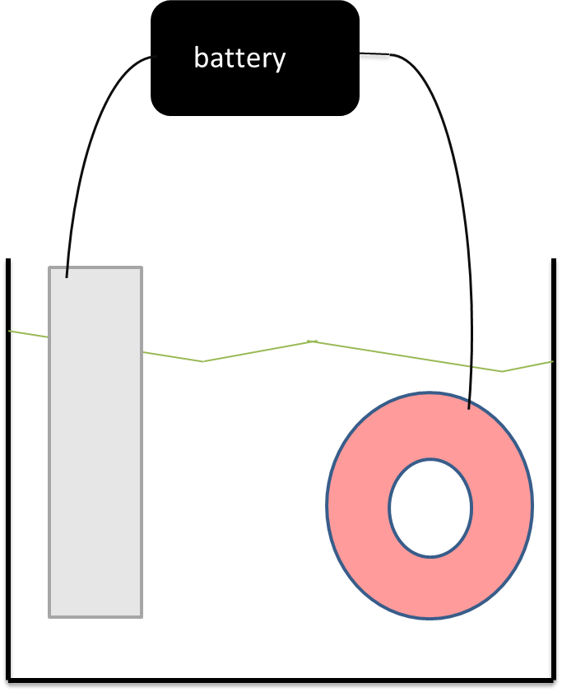
Label this electrolytic cell.
We will plate platinum metal onto the aluminum ring.
The solution is platinum (IV) chlorate.
Note, I turned this around, so you must also turn around the battery, make sure the electrons end up on the ring, or else!
Then write the half reactions and the net ionic equation.

Slide 25
Battery
Voltaic Cell
½ OX Pt° → Pt⁺⁴ + 4e–
½ RED Pt⁺⁴ + 4e– → Pt°
NET Pt° + Pt⁺⁴ → Pt° + Pt⁺⁴
on bar in the solution Onto ring into solution
Al⁺³ does not participate.
Platinum plates onto the aluminum ring.
OX RED
anode
Pt°
Pt⁺⁴
Pt°
Al°
ClO⁻¹
cathode

Slide 26
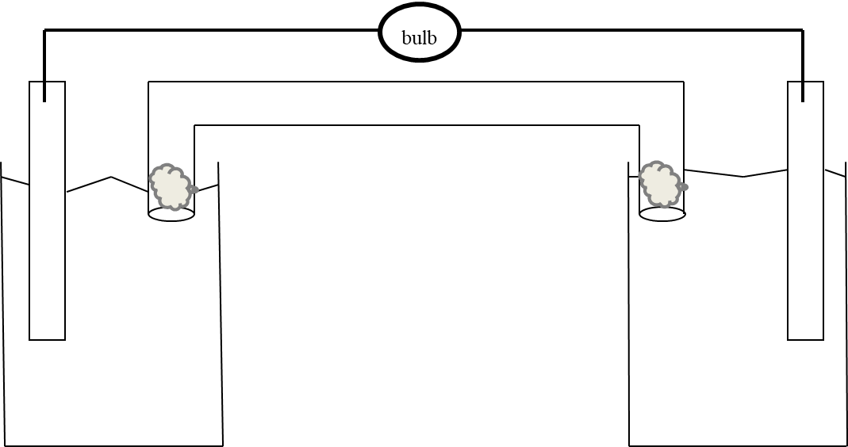
Label this completely, show arrows in solutions, electron flow arrows, ion flow arrows, solution charges and solution charges becoming net zero, label anode and cathode, then write 2 half reactions, a net ionic equation, and name 3 reasons this voltaic cell stops producing electricity. FAST.
At left, lithium metal in a lithium nitrate solution.
At right, nickel metal into a nickel (III) chlorate solution.
The salt bridge is sodium chloride.

Slide 27
NaCl_{(AQ)}
e–
–
Li°
+
Ni°
Li⁺¹
Ni⁺³
OX
RED
OX is on the left (lithium higher than nickel on table J)
Show flow of electrons from Li electrode to nickel electrode.
Solutions get charged instantly (this is bad).

Slide 28
Cl⁻¹
Na⁺¹
e–
–
Li°
+
Ni°
Li⁺¹
Ni⁺³
OX
RED
Sodium ions migrate to the left beaker, making the negative solution neutral again.
Chloride anions migrate to the right beaker, making the positive solution neutral again.
The metal bars are the anode and cathode. Leo is a RED CAT!

Slide 29
Anode
CAThode
Cl⁻¹
Na⁺¹
e–
–
Li°
+
Ni°
Li⁺¹
Ni⁺³
OX
RED
Sodium ions migrate to the left beaker, making the negative solution neutral again.
Chloride anions migrate to the right beaker, making the positive solution neutral again.
The metal bars are the anode and cathode. Leo is a RED CAT!

Slide 30
Anode
Cathode
Cl⁻¹
Na⁺¹
e–
+
−
Li°
Ni°
Li⁺¹
Ni⁺³
OX
RED
½ OX 3Li° → 3Li⁺¹ + 3e–
½ RED Ni⁺³ + 3e – → Ni°
NET 3Li° + Ni⁺³ → 3Li⁺¹ + Ni°
Battery dies when
it runs out of
Anode
Cathode side cations
Salt ions

